Slide 1
Debugging in Hadoop

Slide 2
Unit Test
The map and reduce functions in MapReduce are easy to test in isolation, which is a consequence of their functional style. For known inputs, they produce known outputs.
The following example is a program calculating the max temperature in Hadoop framework

Slide 3
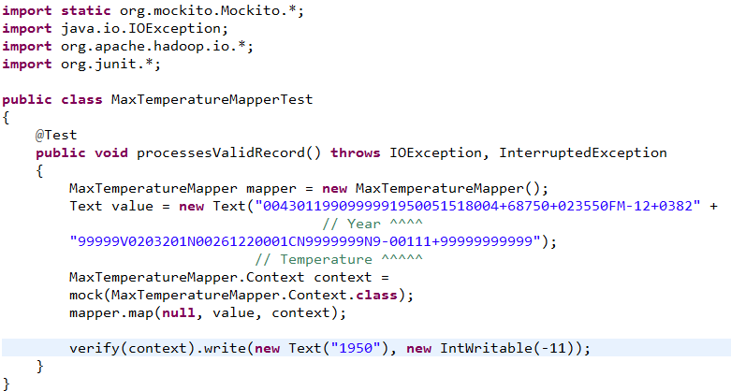
Unit Test
Unit test driver for mapper:
Mockito is an open source testing framework for Java
Then checks
the output is the year and temperature reading
It passes a weather record as input to the mapper

Slide 4
Unit Test
mock() To create a mock Context, we call Mockito’s mock() method (a static import), passing the class of the type we want to mock.
Map() Then we invoke the mapper’s map() method, which executes the code being tested.
Verify() Here we verify that Context’s write() method was called with a Text object representing the year (1950) and an IntWritable representing the temperature (−1.1°C).

Slide 5
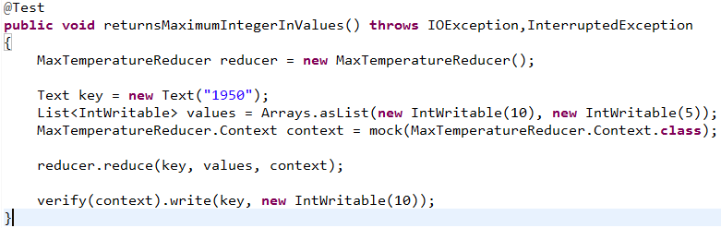
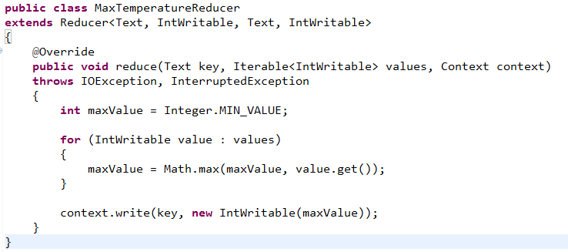
Unit Test
Unit test driver for reducer:
Source code for reducer
Two parameter for the reducer to compare with

Slide 6
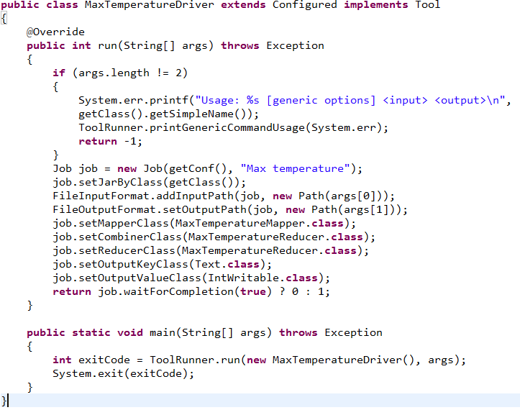
Unit Test
A tool interface that supports handling of generic command-line options.
A driver test the job
By adding a driver class which can run the job in custom configuration, the job can be tested locally
ToolRunner can be used to run classes implementing Tool interface

Slide 7
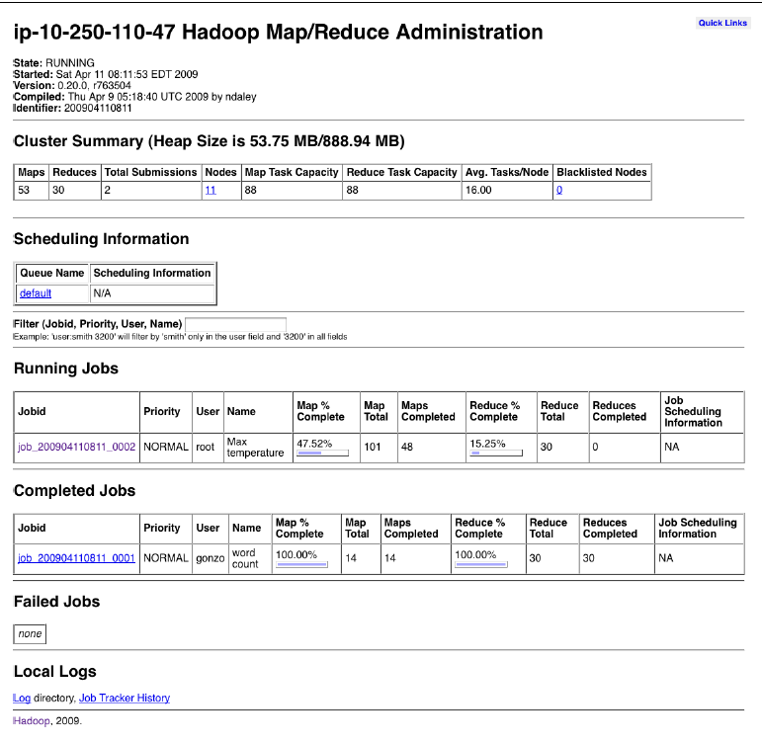
The MapReduce Web UI-The jobtracker page
Details of the Hadoop installation
number of maps and reduces
number of job submissions
number of tasktracker nodes currently available
cluster’s capacity
number of map and reduce slots available across
the cluster
number of available slots per node
number of tasktrackers that have been blacklisted by the jobtracker
Sections for running, (successfully) completed, and failed jobs. Each of these sections has a table of jobs, with a row per job that shows the job’s ID,
Links to the jobtracker’s logs, and the jobtracker’s history: information on all the jobs that the jobtracker has run.

Slide 8
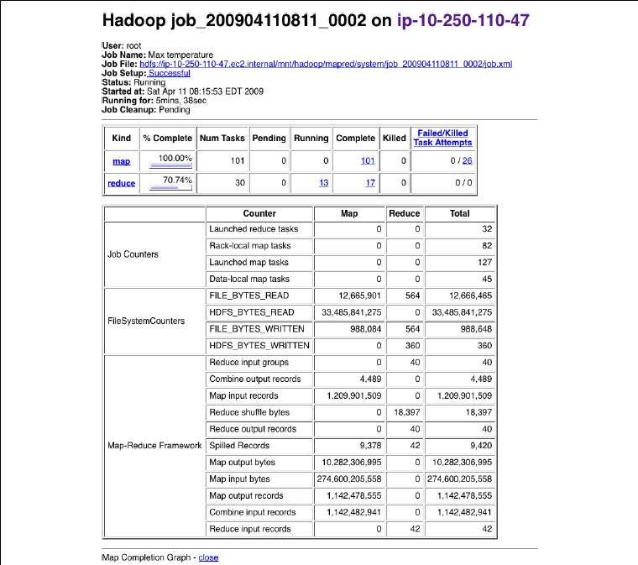
The MapReduce Web UI- The job page
job owner and name
The job file is the consolidated configuration file for the job, containing all the properties and their values that were in effect during the job run
how long the job has been running for
“Num Tasks” shows the total number of map and reduce tasks for this job
(a row for each)

Slide 9
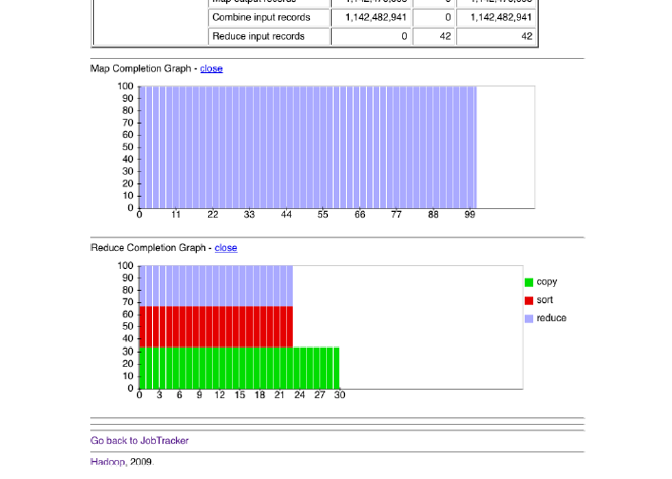
The MapReduce Web UI- The job page
The reduce completion graph is divided into the three phases of
the reduce task:
1. copy (when the map outputs are being transferred to the reduce’s tasktracker),
2. sort (when the reduce inputs are being merged),
3. reduce (when the reduce function is being run to produce the final output).

Slide 10
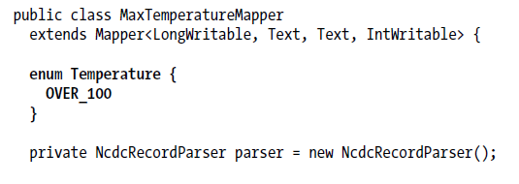
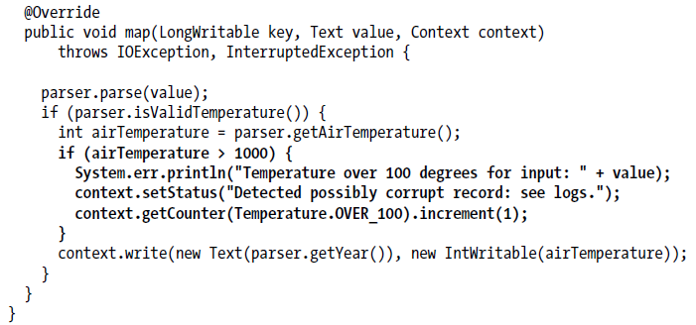
Debugging a Job
Log
Status
Counter

Slide 11
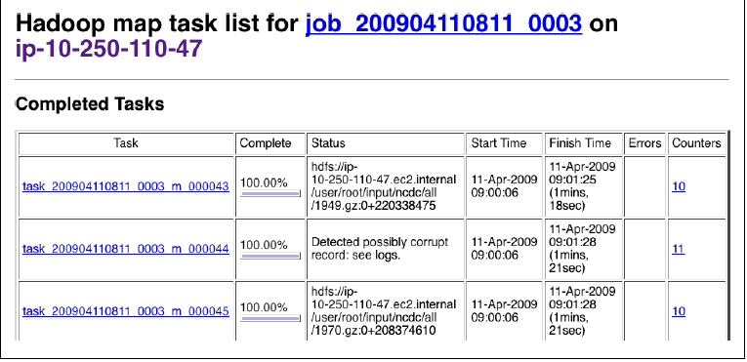
Debugging a Job
Screenshot of the tasks page

Slide 12
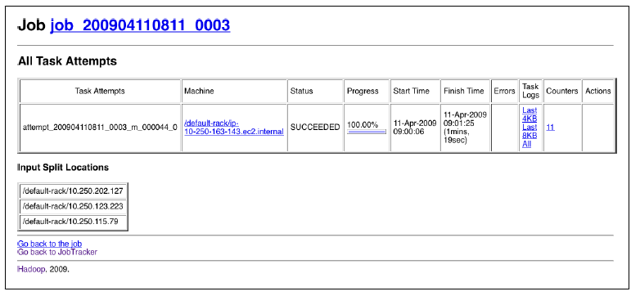
Debugging a Job
Screenshot of the task details page, we can access here by click on the link
In previous slide

Slide 13
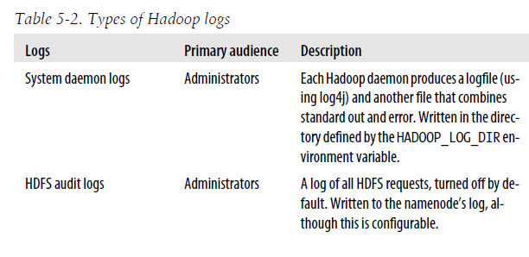
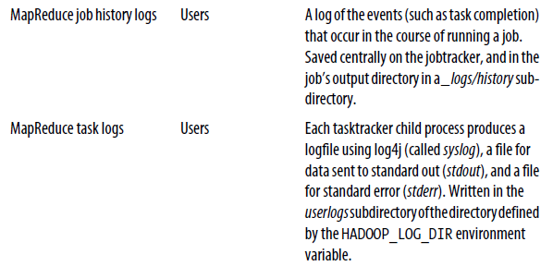
Logs
System Log
Audit Logging
Job History
Stdout

Slide 14
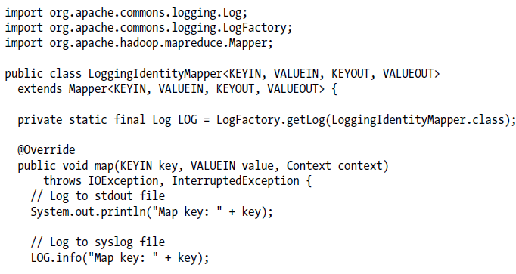
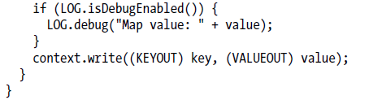
Logs

